Slide 1
AI-Powered Interview Coach
    Your Name: Srushti Nawghane
Subject / Project Title:AI-Powered Interview Coach
Guide Name: Mr. Praveen Kumar
Date:13/02/2026
Email: srushtinawghane868@gmail.com

Slide 2
Introduction
What is AI-Powered Interview Coach?
AI-Powered Interview Coach is a web-based platform that:
Analyzes user resumes using AI
Identifies skill levels
Generates domain-based mock interview questions
Tracks performance and improvement
Provides structured feedback
It acts as a personalized AI interviewer for job preparation.

Slide 3
Problem Statement
Problem
Many students and job seekers:
Don’t know how good their resume actually is
Lack personalized interview practice
Practice generic questions (not resume-based)
Don’t track performance progress
Feel underprepared for real interviews
There is no intelligent system that:
Reads their resume
Understands their skills
Asks personalized questions
Tracks improvement over time

Slide 4
So what is the Solution:
Our Solution
I developed a system that:
Allows users to upload resume (PDF/DOCX)
Extracts text from resume
Uses AI to:
  Analyze skill level
  Evaluate readiness
  Generate improvement roadmap
Conducts mock interview based strictly on resume skills
Tracks performance and analytics
Displays progress dashboard

Slide 5
System Architecture
User → Frontend → Backend → AI Model → Database → Dashboard
Frontend: HTML, CSS, JavaScript
Backend: Node.js, Express
Database: MongoDB
AI Model: Gemini / AI API
Resume Parsing: pdf-parse / mammoth
Technologies Used:
Tech Stack
Frontend: HTML, CSS, JavaScript
Backend: Node.js, Express.js
Database: MongoDB
AI Integration: Gemini / AI API
Resume Parsing:
  pdf-parse
  mammoth (DOCX)

Slide 6
Features
Challenges Faced During Development
Key Features
Resume Upload & Validation
AI-Based Resume Analysis
Skill Extraction
Level Detection (Beginner / Intermediate / Advanced)
Mock Interview Generator
Performance Tracking Dashboard
Skill Distribution Analytics
Smart Fallback System
Technical Challenges Faced
Resume Parsing Errors
  PDF extraction failures
  DOCX formatting issues
AI Model Integration Issues
  Gemini model 404 errors
  API quota limitations
  Wrong API version
Handling Undefined Data
  Frontend crashing due to missing fields
  for Each undefined error
Dynamic Graph Instability
  Auto-scaling issues
  Animation glitches
Backend–Frontend Integration
  Port mismatch (3000 vs 8080)
  Static file serving issues
Smart Fallback Mode :Ensuring structured JSON even when AI fails

Slide 7
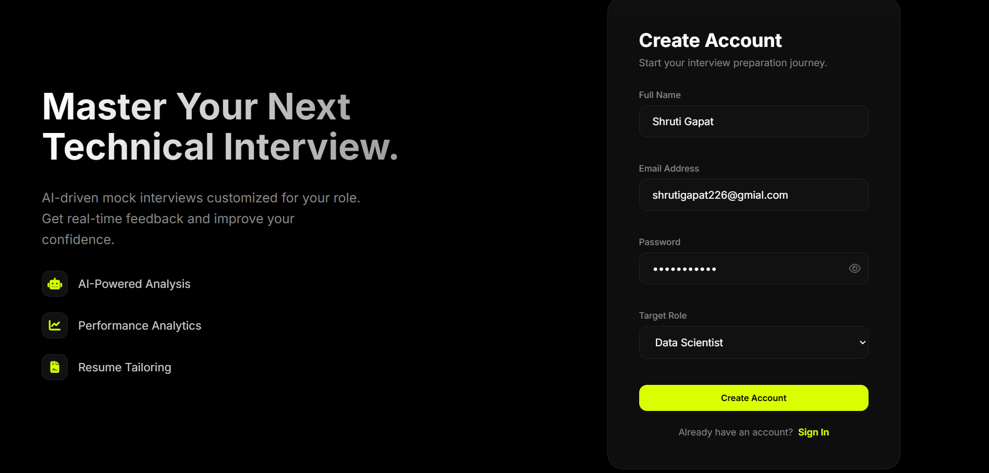
Registration Page:

Slide 8
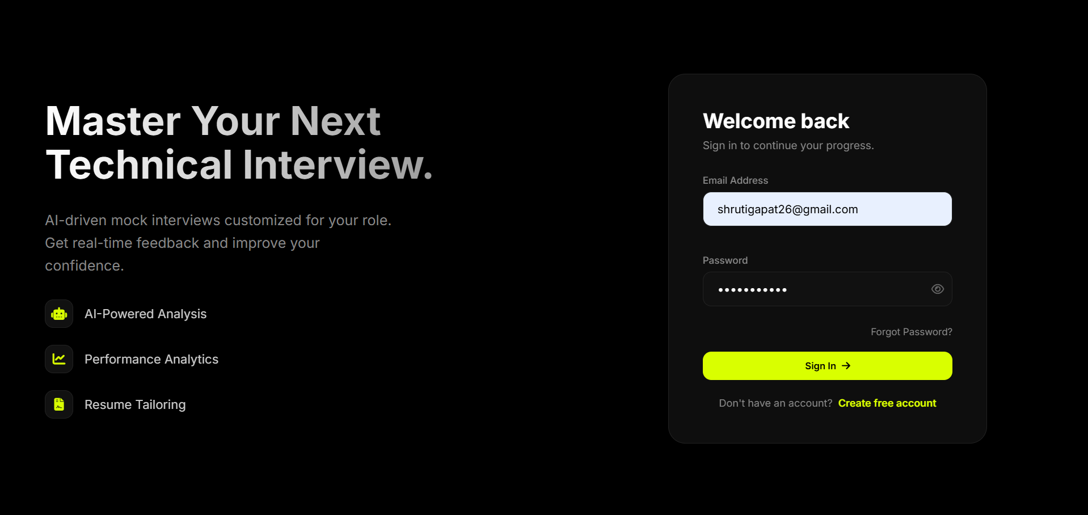
Login Page:

Slide 9
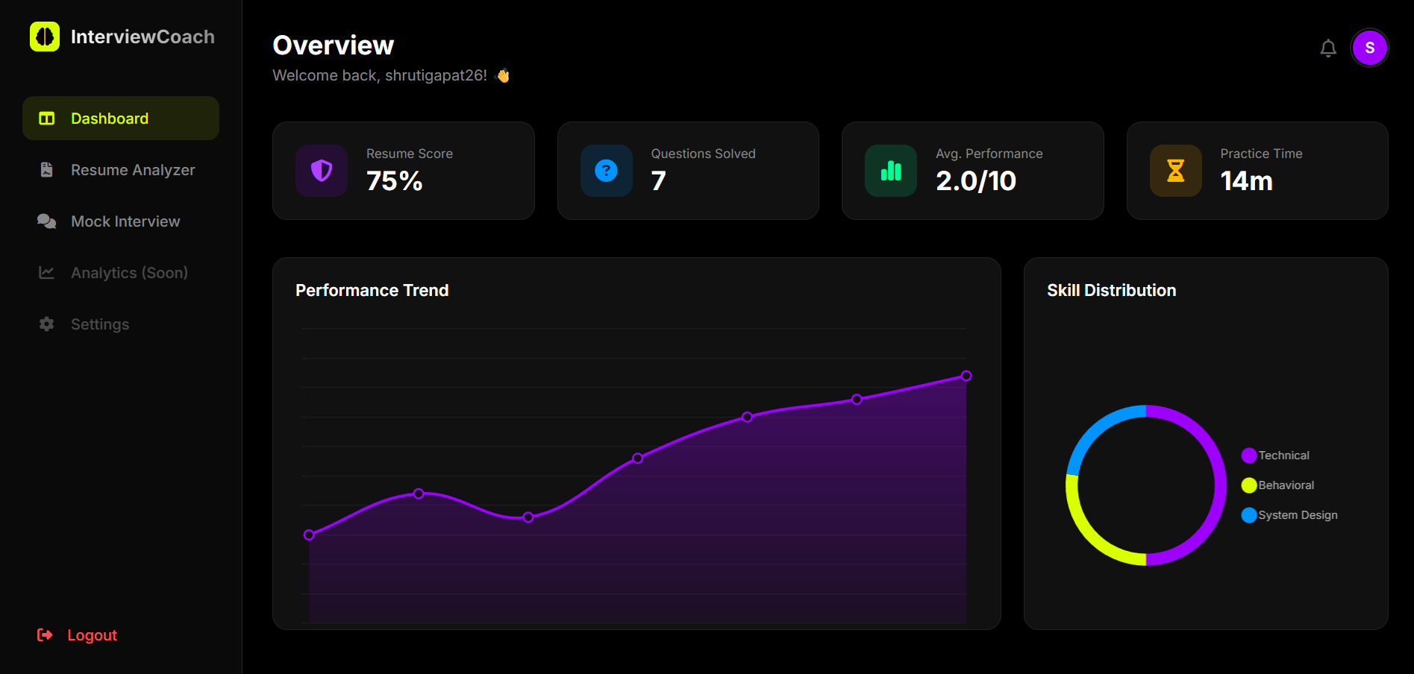
Dashboard Analytics:

Slide 10
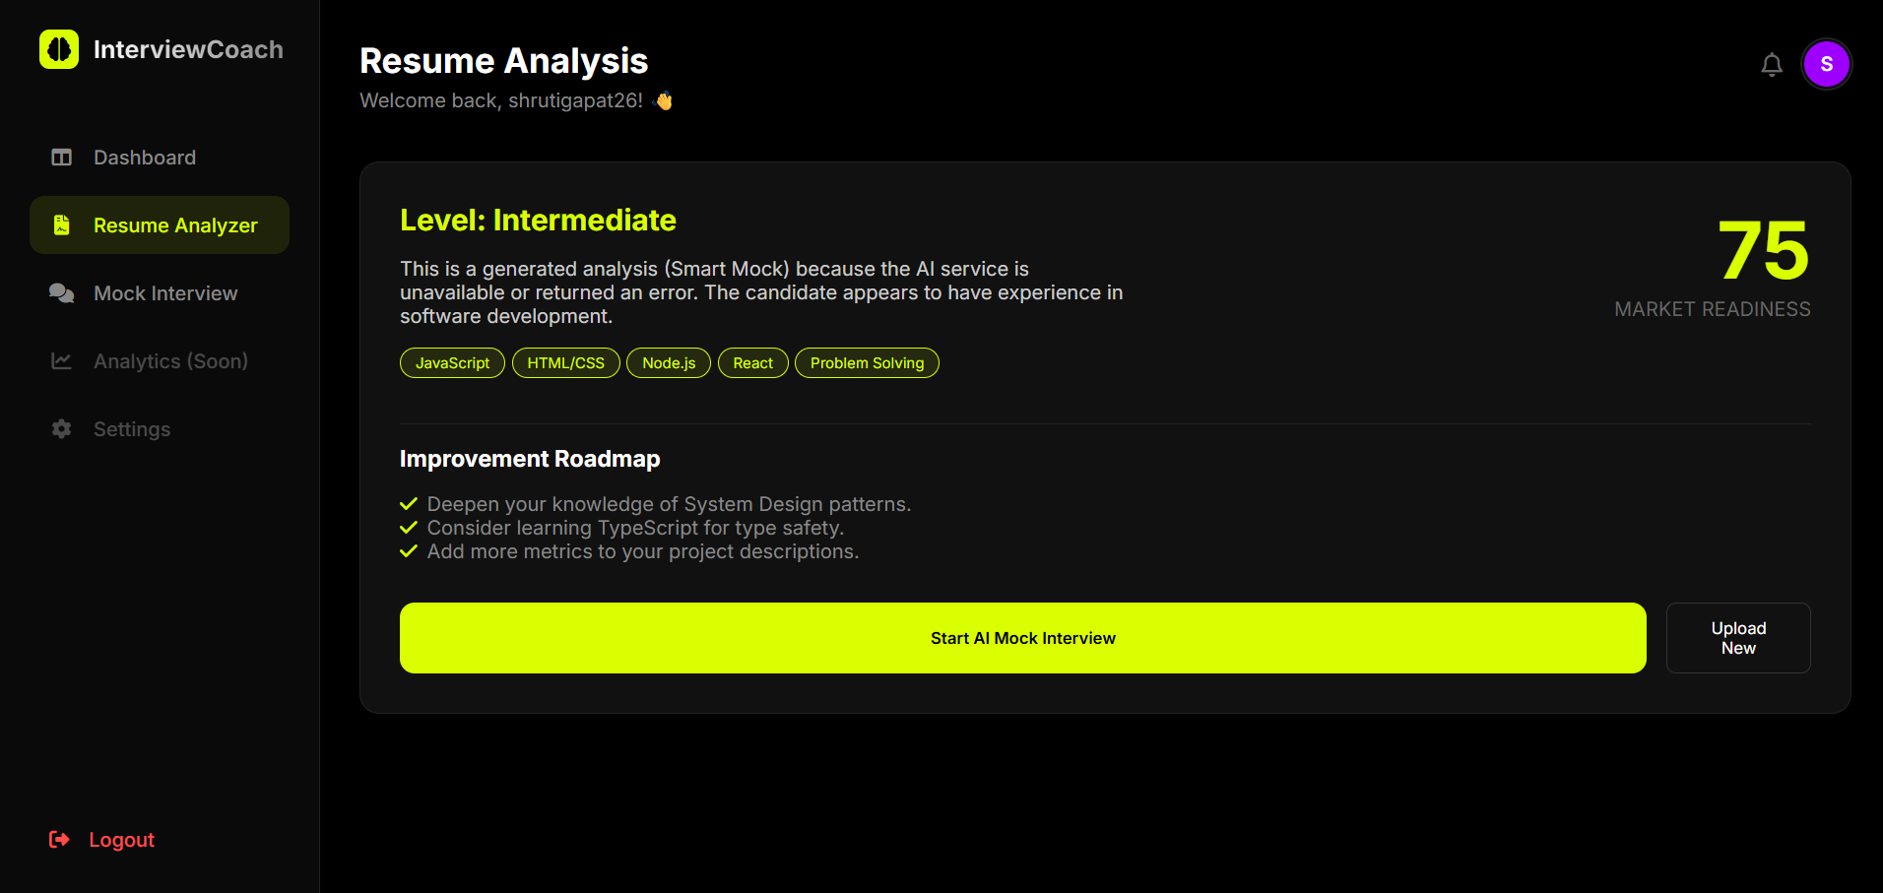
Resume Upload Page:

Slide 11
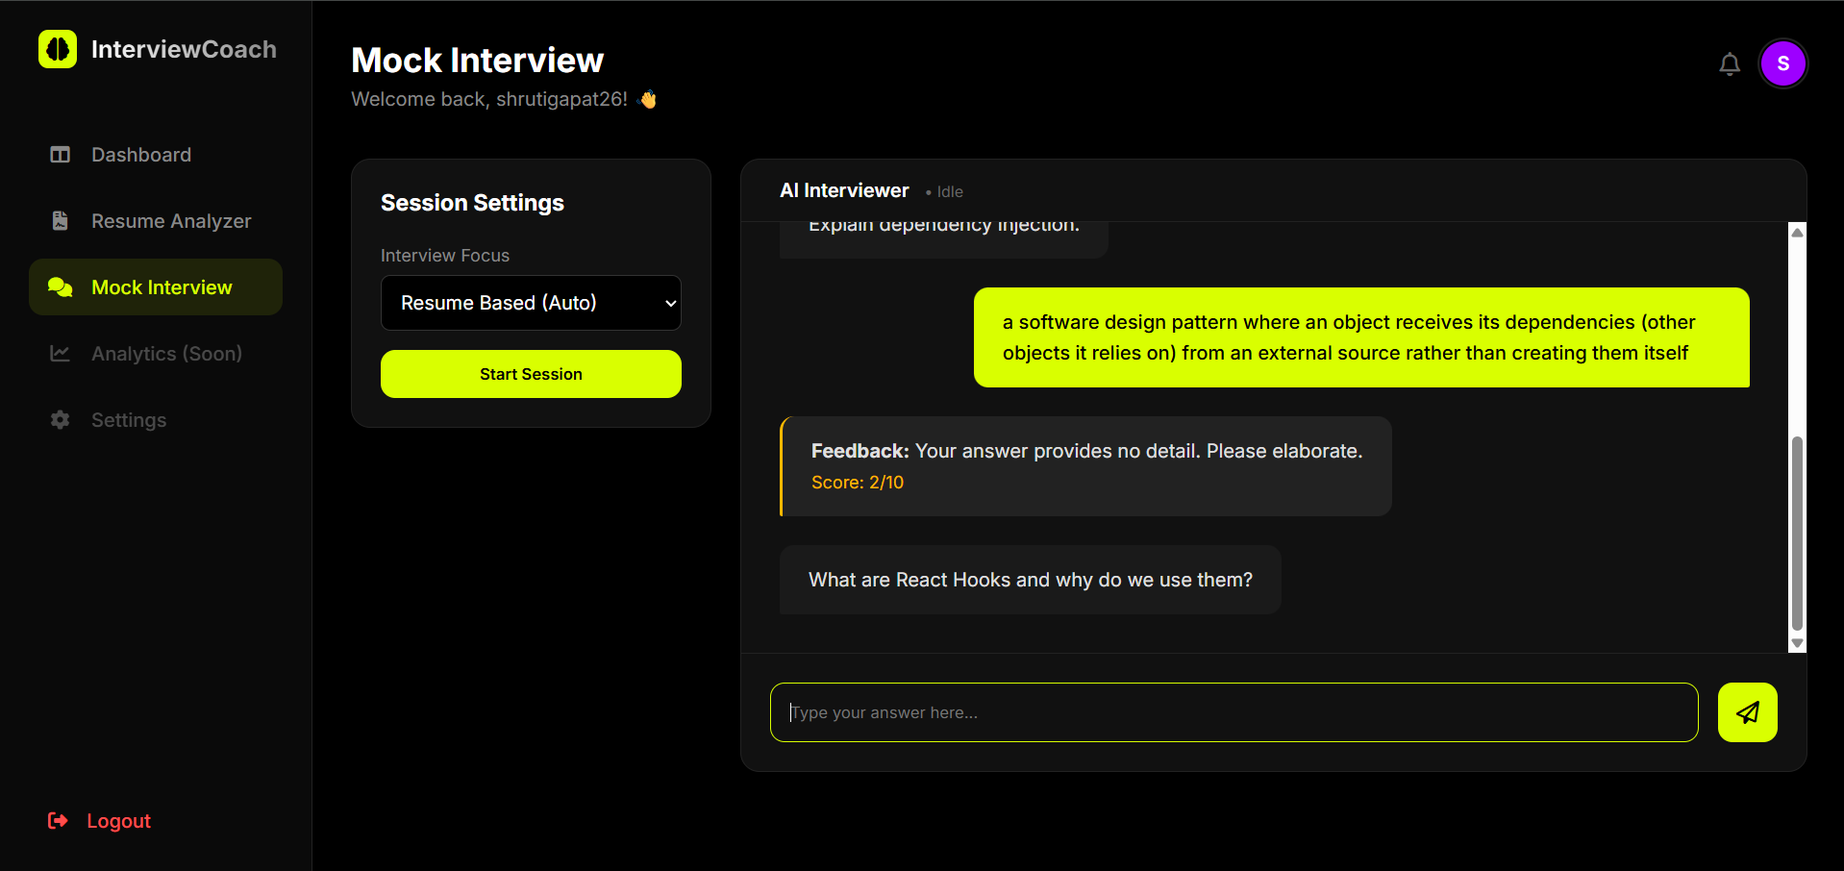
Mock Interview Section:

Slide 12

Working Flow:
How It Works
User uploads resume
Backend extracts text
AI analyzes skills
Structured response generated
Questions generated based on skills
User answers
AI evaluates performance
Dashboard updates automatically

Slide 13
Advantages
Limitations
Personalized interview preparation
Resume-based question generation
Performance tracking
Real-time analytics
AI-driven insights
User-specific skill evaluation
Dependent on AI API availability Requires internet connection Resume parsing may fail for scanned PDFs Performance depends on AI model accuracy

Slide 14
Future Enhancements:
Video-based AI interview
Voice evaluation
Emotion detection
Company-specific question sets
ATS score evaluation
AI career roadmap planning
Cloud deployment
Mobile app version

Slide 15
Conclusion:
The AI-Powered Interview Coach successfully:
Automates resume analysis
Personalizes interview preparation
Tracks performance growth
Simulates real interview environment
It bridges the gap between preparation and real-world interviews.
This project demonstrates practical integration of:
AI
Web Development
Database Systems
Analytics

Slide 16
thank you

